Slide 1



UBMK’24
Enhancing the quality of clustering job skills through the fine-tuning of the sentence transformer model
V. S. Ramazanova, M. A. Sambetbayeva, S. K. Serikbayeva, A. S. Yerimbetova, Zh. B. Sadirmekova
Affiliation: L.N. Gumilyov Eurasian National University, Department of Information Systems, Kazakhstan
IX. INTERNATIONAL CONFERENCE ON COMPUTER SCIENCE AND ENGINEERING (UBMK 2024)
37. BİLGİSAYAR MÜHENDİSLİĞİ BÖLÜM BAŞKANLARI KURULU TOPLANTISI

Slide 2
Introduction
In today's world, education and professional skills play a key role in a successful career. The rapid growth of skills and qualifications data available through online job platforms provides a rich source of information on current labor market trends. However, due to the volume and diversity of this data, it is necessary to apply clustering methods, which play a crucial role in structuring it.
Conducting skill clustering based on embeddings obtained using Sentence Transformers out of the box has shown good results in grouping skills, although these results are not sufficiently accurate. These results can be improved by fine-tuning the Sentence Transformers model on domain-specific data.
The main goal of this study is to improve the quality of skill clustering by fine-tuning the Sentence Transformers model on data related to the information technology field.
IX. INTERNATIONAL CONFERENCE ON COMPUTER SCIENCE AND ENGINEERING (UBMK 2024)
37. BİLGİSAYAR MÜHENDİSLİĞİ BÖLÜM BAŞKANLARI KURULU TOPLANTISI

Slide 3
Methodology
Data collection: Skills data was collected from the online recruitment platform hh.kz via API over a period of two months from 177 locations in Kazakhstan for 25 IT professions. The dataset includes 5,248 vacancies and 3,047 uniquely formulated skills in Russian and English.
Embedding model: The multilingual Sentence Transformers: paraphrase-multilingual-mpnet-base-v2 (2021) model was used to generate skill embeddings before and after fine-tuning.
Clustering: Agglomerative clustering, DBSCAN, HDSCAN, and K-means algorithms were used to identify groups of similar skills.
IX. INTERNATIONAL CONFERENCE ON COMPUTER SCIENCE AND ENGINEERING (UBMK 2024)
37. BİLGİSAYAR MÜHENDİSLİĞİ BÖLÜM BAŞKANLARI KURULU TOPLANTISI

Slide 4



Brief description of the Sentence Transformers model
Paraphrase-multilingual-mpnet-base-v2 is a pre-trained Transformer model designed for generating text embeddings, it maps sentences and paragraphs into a 768-dimensional dense vector space. The model is trained on more than fifty languages ​​and optimized to produce vectors that effectively represent the semantic content of the text, making the embeddings especially useful for tasks related to paraphrase retrieval, semantic retrieval, and text clustering. The embeddings produced by this model reflect the semantic and contextual features of the text, making them suitable for grouping texts by meaning.
Clustering is the task of grouping a set of objects into subsets (clusters) in such a way that objects from one cluster are more similar to each other than to objects from other clusters by some criterion. Clustering is one of the traditional methods in detecting communities in the structure of knowledge graphs.
IX. INTERNATIONAL CONFERENCE ON COMPUTER SCIENCE AND ENGINEERING (UBMK 2024)
37. BİLGİSAYAR MÜHENDİSLİĞİ BÖLÜM BAŞKANLARI KURULU TOPLANTISI

Slide 5
Experimental settings for fine-tuning Sentence Transformers
Training dataset: To fine-tune the model, a multilingual skills training dataset was created containing 9,336 paraphrase pairs in Russian, English, and Kazakh, as well as an additional set of 3,095 pairs in Russian.
Testing datasets: Validation and testing were performed on publicly available datasets such as STSB for English and RuSTSBenchmarkSTS for Russian.
Loss function: The model was tuned using the MultipleNegativesRankingLoss loss function, which is effective for dealing with pairs of similar texts such as paraphrases or repeated questions.
Evaluation of embedding model training: EmbeddingSimialityEvaluator - evaluates the model by computing the Pearson correlation and Spearman rank correlation between the computed embedding similarity and the gold standard labels of the test datasets.
Similarity Metrics: Semantic similarity of phrases was assessed using cosine similarity, Manhattan distance, Euclidean distance, and dot product similarity.
IX. INTERNATIONAL CONFERENCE ON COMPUTER SCIENCE AND ENGINEERING (UBMK 2024)
37. BİLGİSAYAR MÜHENDİSLİĞİ BÖLÜM BAŞKANLARI KURULU TOPLANTISI

Slide 6
Experimental settings for fine-tuning Sentence Transformers
For three stages: num_epochs = 1; 1; 2;
For English dataset: train_batch_size = 64
For Russian dataset: train_batch_size = 32
max_seq_length = 128
eval_strategy="steps"
eval_steps=40
save_strategy="steps"
save_steps=40
IX. INTERNATIONAL CONFERENCE ON COMPUTER SCIENCE AND ENGINEERING (UBMK 2024)
37. BİLGİSAYAR MÜHENDİSLİĞİ BÖLÜM BAŞKANLARI KURULU TOPLANTISI

Slide 7
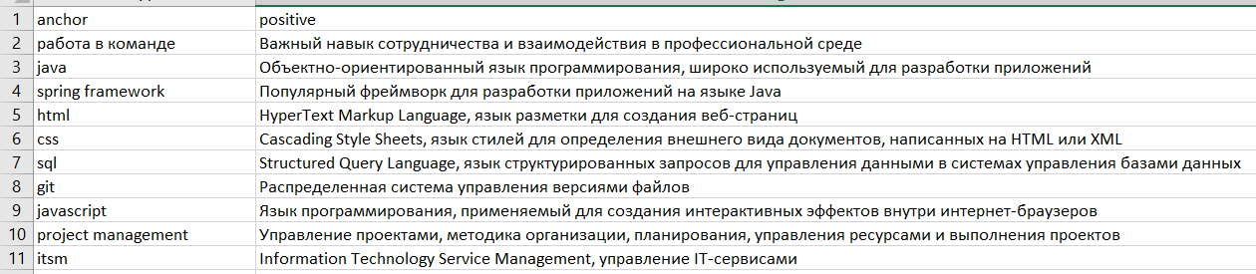
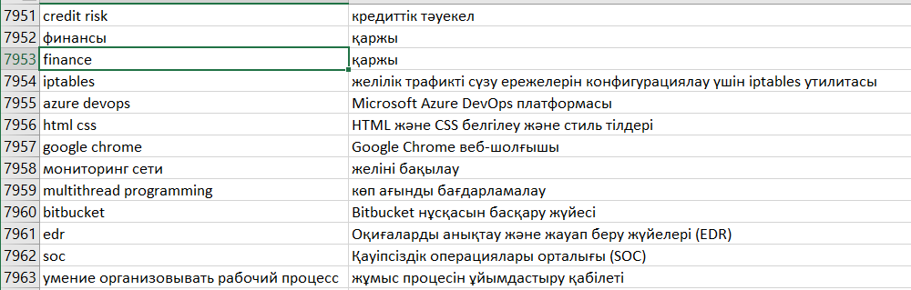
Experimental settings for fine-tuning Sentence Transformers
Sample from the training dataset in Russian
Sample from the training dataset in Kazakh
IX. INTERNATIONAL CONFERENCE ON COMPUTER SCIENCE AND ENGINEERING (UBMK 2024)
37. BİLGİSAYAR MÜHENDİSLİĞİ BÖLÜM BAŞKANLARI KURULU TOPLANTISI
IX. INTERNATIONAL CONFERENCE ON COMPUTER SCIENCE AND ENGINEERING (UBMK 2024)
37. BİLGİSAYAR MÜHENDİSLİĞİ BÖLÜM BAŞKANLARI KURULU TOPLANTISI

Slide 8
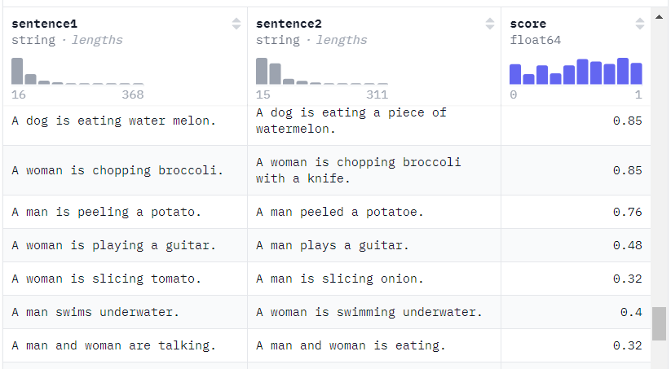
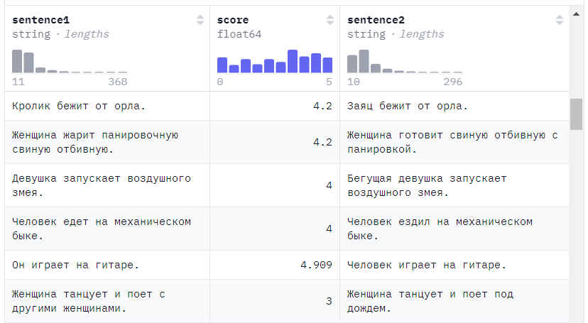
Experimental settings for fine-tuning Sentence Transformers
Sample from the validation and testing dataset in English
Sample from the validation and testing dataset in Russian
IX. INTERNATIONAL CONFERENCE ON COMPUTER SCIENCE AND ENGINEERING (UBMK 2024)
37. BİLGİSAYAR MÜHENDİSLİĞİ BÖLÜM BAŞKANLARI KURULU TOPLANTISI

Slide 9
Fine-Tuning Sentence Transformers: Results
Comparison of model evaluating before and after fine-tuning on test datasets: English Russian and Kazakh (translated from English)
Metrics | Before training |  | After training
Cosine-Similarity
Pearson | 0,8543 | 0,8543 | 0,8546
Spearman | 0,8682 | 0,8682 | 0,8601
Manhattan-Distance
Pearson | 0,8635 | 0,8635 | 0,8604
Spearman | 0,8613 | 0,8613 | 0,8574
Euclidean-Distance
Pearson | 0,8648 | 0,8648 | 0,8610
Spearman | 0,8630 | 0,8630 | 0,8586
Dot-Product-Similarity
Pearson | 0,8271 | 0,8271 | 0,8225
Spearman | 0,8227 | 0,8227 | 0,8111
Metrics | Before training | After training
Cosine-Similarity
Pearson | 0,8125 | 0,8221
Spearman | 0,8246 | 0,8237
Manhattan-Distance
Pearson | 0,8075 | 0,8206
Spearman | 0,8095 | 0,8218
Euclidean-Distance
Pearson | 0,8079 | 0,8210
Spearman | 0,8109 | 0,8227
Dot-Product-Similarity
Pearson | 0,7172 | 0,7565
Spearman | 0,6959 | 0,7360
Metrics | Before training | After training
Cosine-Similarity
Pearson | 0.5989 | 0.6050
Spearman | 0.5906 | 0.5900
Manhattan-Distance
Pearson | 0.5512 | 0.5720
Spearman | 0.5419 | 0.5665
Euclidean-Distance
Pearson | 0.5504 | 0.5710
Spearman | 0.5421 | 0.5662
Dot-Product-Similarity
Pearson | 0.4487 | 0.4912
Spearman | 0.4308 | 0.4773
Result: After fine-tuning, it was found that for the English dataset the parameters remained almost unchanged, however, on the test dataset for Russian and Kazakh languages, the model improved performance for most similarity metrics.
IX. INTERNATIONAL CONFERENCE ON COMPUTER SCIENCE AND ENGINEERING (UBMK 2024)
37. BİLGİSAYAR MÜHENDİSLİĞİ BÖLÜM BAŞKANLARI KURULU TOPLANTISI

Slide 10

Experimental settings for clastering
Dataset: 3047 uniquely worded skills in Russian and English.
Visualization of clustering results: T-SNE is a non-linear dimensionality reduction method that is used to visualize high-dimensional data in two-dimensional or three-dimensional space.
Clustering evaluation:
Silhouette coefficient, varies from -1, indicating unsuccessful clustering, to +1, indicating the presence of dense and clearly separated clusters. a - the average distance between a sample and all other points in the same cluster. b - the average distance between a sample and all other points in the next closest cluster. The silhouette coefficient s for one sample is then defined as: The silhouette coefficient for a set of samples is defined as the average value of the silhouette coefficient for each sample.
Expert assessment, visual inspection of clusters
Clustering technique | Key parameters
Agglomerative | Distance Threshold=0.2..0.5, metric=cosine, linkage=average
DBSCAN | Eps=0.3..0.7, min_samples=1, metric=cosine
HDBSCAN | Metric=Eucledean, min_cluster_size=2, min_samples=1
K-Means | num_clusters=400..1800 random_state=42
IX. INTERNATIONAL CONFERENCE ON COMPUTER SCIENCE AND ENGINEERING (UBMK 2024)
37. BİLGİSAYAR MÜHENDİSLİĞİ BÖLÜM BAŞKANLARI KURULU TOPLANTISI

Slide 11
Clustering: Results
Parameters and results of agglomerative clustering before and after fine tuning of the embedding model
Embedding Model Fine-Tuning | Distance threshold | Number of clusters | Average Silhouette coefficient
Before Fine-Tuning | 0,2 | 1669 | 0,25506
 | 0,25 | 1335 | 0,27106
 | 0,27 | 1221 | 0,26728
 | 0,29 | 1121 | 0,27126
 | 0,31 | 1023 | 0,26873
 | 0,4 | 636 | 0,23460
 | 0,5 | 357 | 0,17152
After Fine-Tuning | 0,3 | 1779 | 0,278 1
 | 0,32 | 1676 | 0,2806
 | 0,35 | 1523 | 0,2823
 | 0,37 | 1407 | 0,2851
 | 0,4 | 1272 | 0,2821
 | 0,44 | 1111 | 0,2753
 | 0,5 | 875 | 0,2661
Comparison of clustering techniques before fine-tuning
Clustering technique | Best key parameters | Best Average Silhouette Coefficient
Agglomerative | threshold = 0,29 | 0,2713
DBSCAN | eps = 0,55 | 0,2092
HDBSCAN | - | 0,0739
K-Means | n_clusters = 1400 | 0,2429
Agglomerative clustering: Comparison of Erroneous Clusters Before and After Training the Embedding Model
Embedding model | Percentage of errorneous clusters
Before fine-tuning | 19,74%
After fine-tuning | 13,97%
Result:
The evaluation reveals that agglomerative clustering achieved the highest Silhouette Coefficient.
The decrease in the percentage of erroneous clusters confirms the improvement of clustering results and the increase in clustering accuracy after fine-tuning.
IX. INTERNATIONAL CONFERENCE ON COMPUTER SCIENCE AND ENGINEERING (UBMK 2024)
37. BİLGİSAYAR MÜHENDİSLİĞİ BÖLÜM BAŞKANLARI KURULU TOPLANTISI

Slide 12
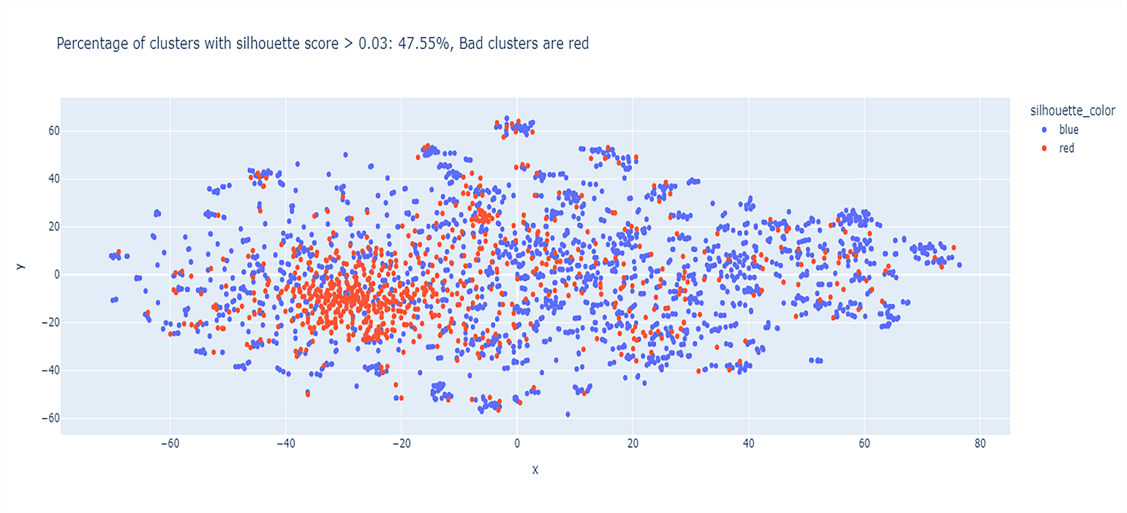
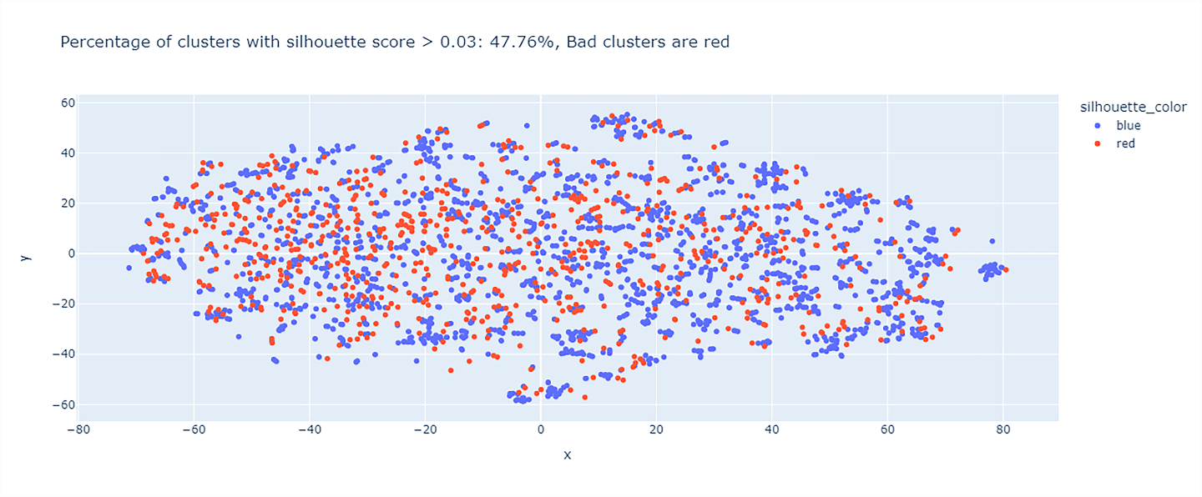
T-SNE visualization of agglomerative clustering results before and after finetuning: the concentration on the left from inaccurate clusters and single skills has disappeared.
Clustering:
Results
IX. INTERNATIONAL CONFERENCE ON COMPUTER SCIENCE AND ENGINEERING (UBMK 2024)
37. BİLGİSAYAR MÜHENDİSLİĞİ BÖLÜM BAŞKANLARI KURULU TOPLANTISI

Slide 13
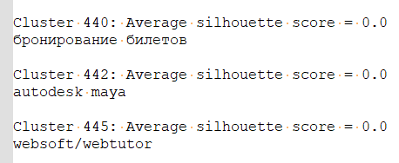
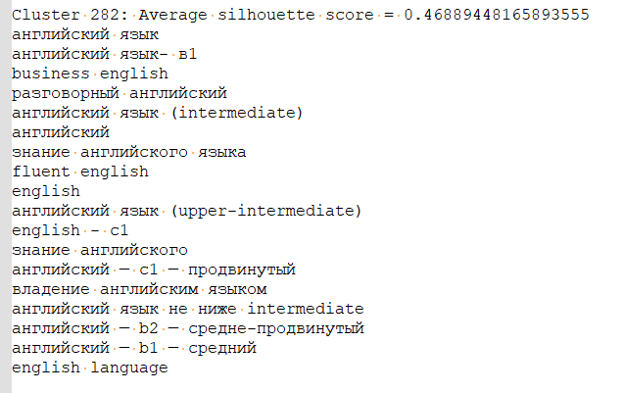
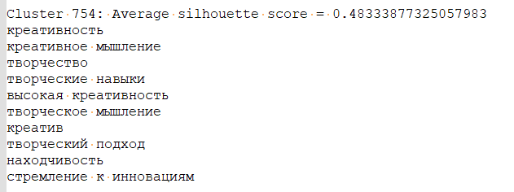
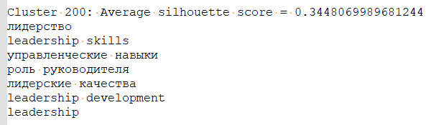
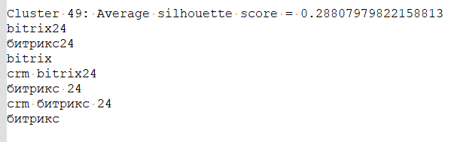
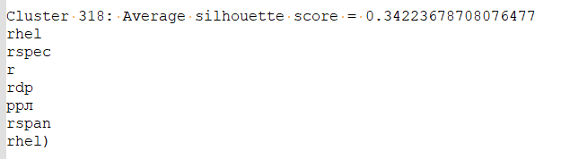
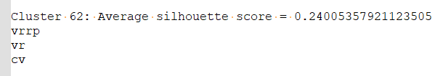
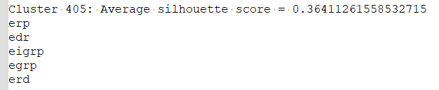
Clustering: Results
Skill samples not included in the cluster
Examples of successful clusters
Examples of erroneous clusters
IX. INTERNATIONAL CONFERENCE ON COMPUTER SCIENCE AND ENGINEERING (UBMK 2024)
37. BİLGİSAYAR MÜHENDİSLİĞİ BÖLÜM BAŞKANLARI KURULU TOPLANTISI

Slide 14
Discussion
The conducted research and experiments on retraining the multilingual Sentence Transformers model on domain data showed improvements as a result of skill clustering.
Despite the positive results, there are certain limitations that must be taken into account. There is a problem with abbreviations. For further improvement of the model and clustering of skills, it may be necessary to expand the abbreviations and create a reference book, test the embedding model on additional domain data.
The quality of fine-tuning the model depends on the size and quality of the training dataset. Validation and testing on the domain dataset will improve the quality of clustering.
Fine-tuning on domain data can improve the quality of the model for a specific domain, but can reduce its universality and applicability to other areas.
Fine-tuning the multilingual Paraphrase-multilingual-mpnet-base-v2 model will contribute to the improvement and development of multilingual Sentence Transformers models for the Russian and Kazakh languages ​​for the information technology domain.
This approach can be used in similar tasks for other languages ​​and domain areas.
IX. INTERNATIONAL CONFERENCE ON COMPUTER SCIENCE AND ENGINEERING (UBMK 2024)
37. BİLGİSAYAR MÜHENDİSLİĞİ BÖLÜM BAŞKANLARI KURULU TOPLANTISI

Slide 15
Conclusions and Future Research
In this paper, experiments were conducted to compare 4 types of clustering and fine-tuning of the multilingual embedding model Sentence Transformers: paraphrase-multilingual-mpnet-base-v2 to improve the clustering results of skills collected from the online recruitment site hh.kz.
The main findings of the study include improved model performance in Russian and Kazakh. It may be necessary to split the training datasets into three parts for three languages ​​and create benchmark testing datasets in the IT field.
The next step will be to create groups of similar skills in the knowledge graph of vacancies based on the clustering results for the recommendation system.
IX. INTERNATIONAL CONFERENCE ON COMPUTER SCIENCE AND ENGINEERING (UBMK 2024)
37. BİLGİSAYAR MÜHENDİSLİĞİ BÖLÜM BAŞKANLARI KURULU TOPLANTISI

Slide 16
References
J. Barrasa, A. E. Hodler, and J. Webber, Knowledge Graphs. O'Reilly Media, 2021.
C. Tjortjis, Ed., Graph Databases: Applications on Social Media Analytics and Smart Cities. CRC Press, 2024, doi: 10.1201/9781003183532.
G. Gricourt, T. Duigou, S. Dérozier, and J.-L. Faulon, “neo4jsbml: import systems biology markup language data into the graph database Neo4j,” PeerJ, vol. 12, e16726, 2024, doi: 10.7717/peerj.16726.
W. Li, et al., “Constructing low-redundant and high-accuracy knowledge graphs for education,” in Learning Technologies and Systems. ICWL SETE 2022 2022, C. S. González-González, et al., Eds. Springer, 2023, doi: 10.1007/978-3-031-33023-0_13.
G. Agrawal, Y. Deng, J. Park, H. Liu, and Y.-C. Chen, “Building knowledge graphs from unstructured texts: Applications and impact analyses in cybersecurity education,” Information, vol. 13, no. 11, p. 526, 2022, doi: 10.3390/info13110526.
Y. Su and Y. Zhang, “Automatic construction of subject knowledge graph based on educational big data,” in Proc. 2020 3rd Int. Conf. Big Data Educ. (ICBDE), 2020, doi: 10.1145/3396452.3396458.
I. Khaouja, I. Kassou, and M. Ghogho, “A survey on skill identification from online job ads,” IEEE Access, vol. 9, pp. 118134-118153, 2021, doi: 10.1109/ACCESS.2021.3106120.
Y. Fettach, M. Ghogho, and B. Benatallah, “Knowledge graphs in education and employability: A survey on applications and techniques,” IEEE Access, vol. 10, pp. 80174-80183, 2022, doi: 10.1109/ACCESS.2022.3194063.
A. Weichselbraun, R. Waldvogel, A. Fraefel, A. van Schie, and P. Kuntschik, “Building knowledge graphs and recommender systems for suggesting reskilling and upskilling options from the web,” Information, vol. 13, no. 11, p. 510, 2022, doi: 10.3390/info13110510.
G. Zhu, Y. Chen, and S. Wang, “Graph-community-enabled personalized course-job recommendations with cross-domain data integration,” Sustainability, vol. 14, p. 7439, 2022, doi: 10.3390/su14127439.
S. Fortunato, “Community Detection in Graphs,” Complex Networks and Systems Lagrange Laboratory, ISI Foundation, 2009, doi: 10.1016/j.physrep.2009.11.002.
E. Oti and M. Olusola, “Overview of Agglomerative Hierarchical Clustering Methods,” British Journal of Computer, Networking and Information Technology, vol. 7, pp. 14-23, 2024, doi: 10.52589/BJCNIT-CV9POOGW.
E. K. Tokuda, C. H. Comin, and L. da F. Costa, “Revisiting agglomerative clustering,” Physica A: Statistical Mechanics and its Applications, vol. 585, 2022, doi: 10.1016/j.physa.2021.126433.
M. Gagolewski, M. Bartoszuk, and A. Cena, “Are Cluster Validity Measures (In)valid?,” Information Sciences, vol. 581, 2021, doi: 10.1016/j.ins.2021.10.004.
T. Söküt Açar and N. Ayman Öz, “The determination of optimal cluster number by Silhouette index at clustering of the European Union member countries and candidate Turkey by waste indicators,”
IX. INTERNATIONAL CONFERENCE ON COMPUTER SCIENCE AND ENGINEERING (UBMK 2024)
37. BİLGİSAYAR MÜHENDİSLİĞİ BÖLÜM BAŞKANLARI KURULU TOPLANTISI

Slide 17
Thank you for your attention
IX. INTERNATIONAL CONFERENCE ON COMPUTER SCIENCE AND ENGINEERING (UBMK 2024)
37. BİLGİSAYAR MÜHENDİSLİĞİ BÖLÜM BAŞKANLARI KURULU TOPLANTISI

